Slide 1
Emergency Protocol Update

Slide 2
Limited Non-Transport For Specific Patients
Purpose: To allow for non-transport of certain patients who may be exhibiting mild COVID-19 symptoms and no other complaints, and who do not appear to require hospital-level care/resources
Applies to: Massachusetts EMTs all Levels
Requires: Completion of algorithm, consultation with on-line medical control (OLMC), completion of PCR to include assessment & patient interaction, name of OLMC
Effective: Immediately, upon completion of in-service
End-date: Upon notification from OEMS
Notes:
This protocol applies only to the specific patients that qualify. EMS is not permitted to solicit refusals from patients with other complaints, or from patients that do not fit the protocol algorithm categories. The EMT completing the interview and assessment must complete a detailed PCR that addresses all of the algorithm conditions. We expect that this protocol will expire when the State of Emergency expires, but we will be formally notified by OEMS/DPH.

Slide 3
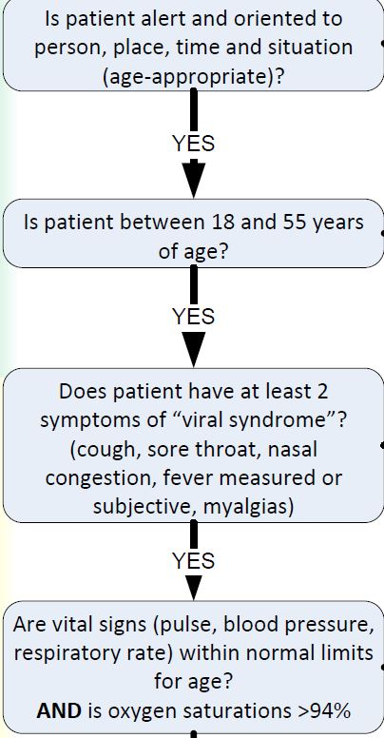
Document findings from each box on your PCR
To qualify for
“Non-Transport”
You must find ‘yes’ for
each category
Notes:
Clearly the patients that would qualify for non-transport must meet specific conditions and will present on the mild side with symptoms. Persons outside the age parameters, regardless of mild symptoms, do not qualify. Note that the provider must obtain vitals, including pulse oximetry.

Slide 4
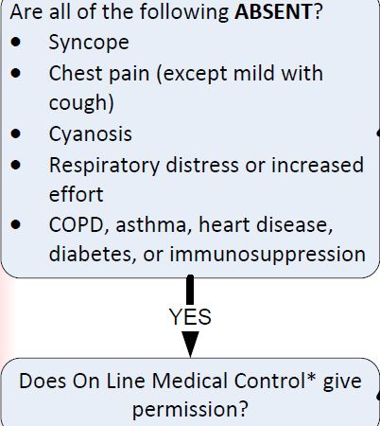
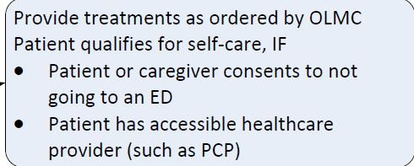
You must find “NO”
for each of these;
Document on PCR
Patient must consent to no-transport;
Document on PCR; NO signature required
Document on PCR
the name of OLMC giving
permission for no transport
Notes:
The patient interview and assessment must include determination of the conditions/symptoms listed. Contact online Medical Control (preferably by recorded phone line, but use radio if necessary). Explain to the patient that Medical Control approves them to self-care at home and obtain agreement from patient. Recommend patient contact their PCP for phone or telehealth consult. Provide ‘informed refusal’ information, i.e., invite patient to call 911 if symptoms worsen and provide examples. NO SIGNATURE is required from these patients. NOTE: expect that some patients may want to be transported because they want to be tested for COVID.

Slide 5
Considerations
Your dispatch center should be made aware of the emergency protocol
As is already recommended, only one EMT with proper PPE should perform assessment and interaction with patient; start with 6-foot assessment if possible.
You must contact online medical control at your AFFILIATED Medical Control Hospital only
Your agency may wish to develop a checklist to gather required criteria for COVID No-Transport protocol.
Notes:
An n95 mask is not needed unless aerosolizing treatments are ongoing. Simple assessment, interview and vital signs requires only a surgical/face mask, eye protection, gloves, gown

Slide 6
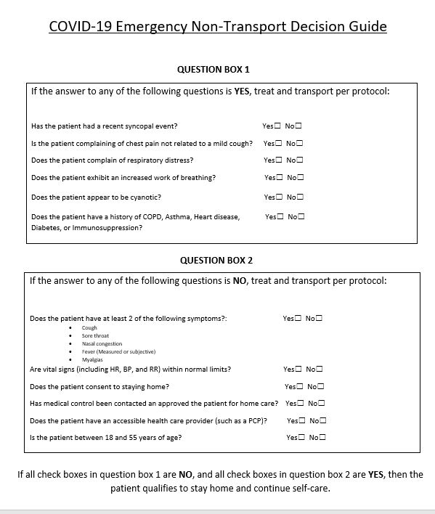
Here is a sample of one
type of checklist provided
by Baystate Health EMS
Coordinators

Slide 7
Medical Control physicians will need to become familiar with this emergency protocol before it can be fully implemented
“Fever” is currently defined as > 99.4°F (37.44°C); “subjective” means if the patient feels they have a fever ~ at present, thermometers are not required on MA ambulances.
If your ambulance carries a thermometer you may use it, following manufacturer’s guidance, please record on PCR.
Notes:
The algorithm specifies fever as ‘measured’ or ‘subjective’ See current definitions on slide Going forward, thermometers have been approved as required equipment for 2021 implementation. Ambulances may carry thermometers currently but are not required. Follow manufacturers’ instructions. ‘No-Touch’ thermometers that scan forehead work best when skin oils are cleaned off of forehead (e.g. with alcohol prep) and thermometer is recommended distance from skin. Tympanic thermometers require replacement probe covers for each patient.

Slide 8
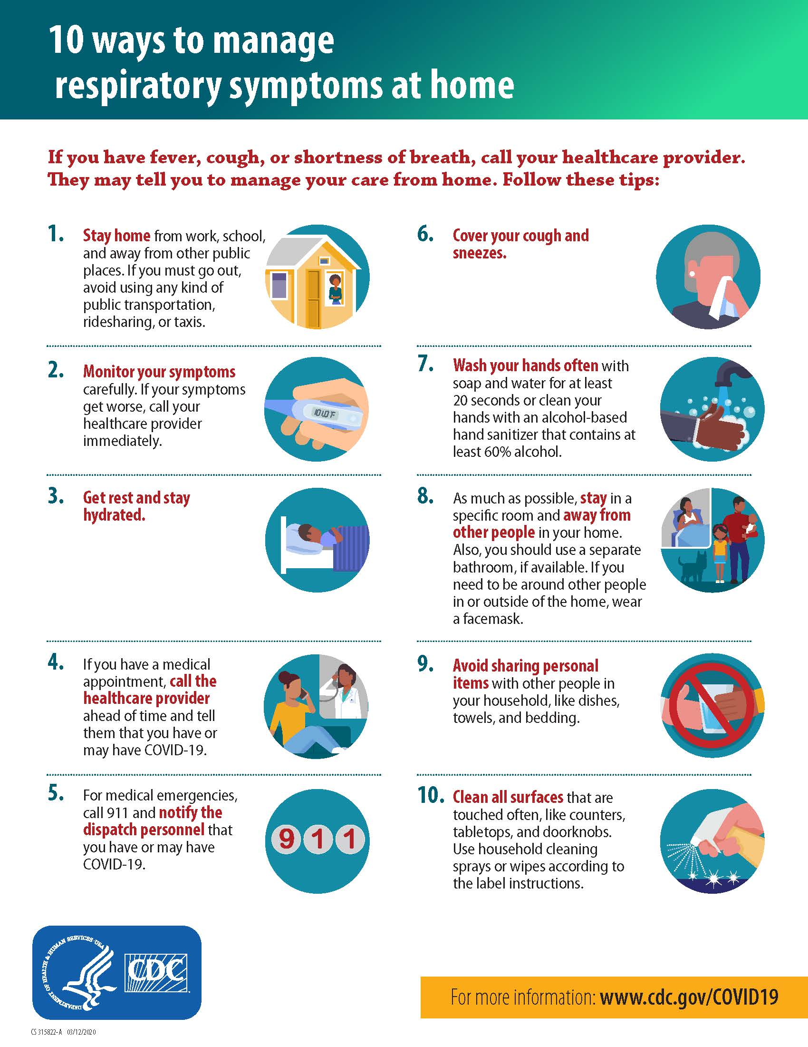
It is suggested to provide a copy of this handout to patients that you do not transport under this protocol
Encourage them to contact their PCP for phone or telehealth follow-up
Remind them to call 911 if they experience worsening symptoms, including difficulty breathing

